Slide 1
FHS Social Emotional Support Tips
October 2021

Slide 2
Overview
Community Resources
Videos, APPS, Teen Programs, Audible books
Helplines
Bench-safe space-bracelets
Mindfulness Video
Student services flYER
Each month-new focus, tips & tricks

Slide 3
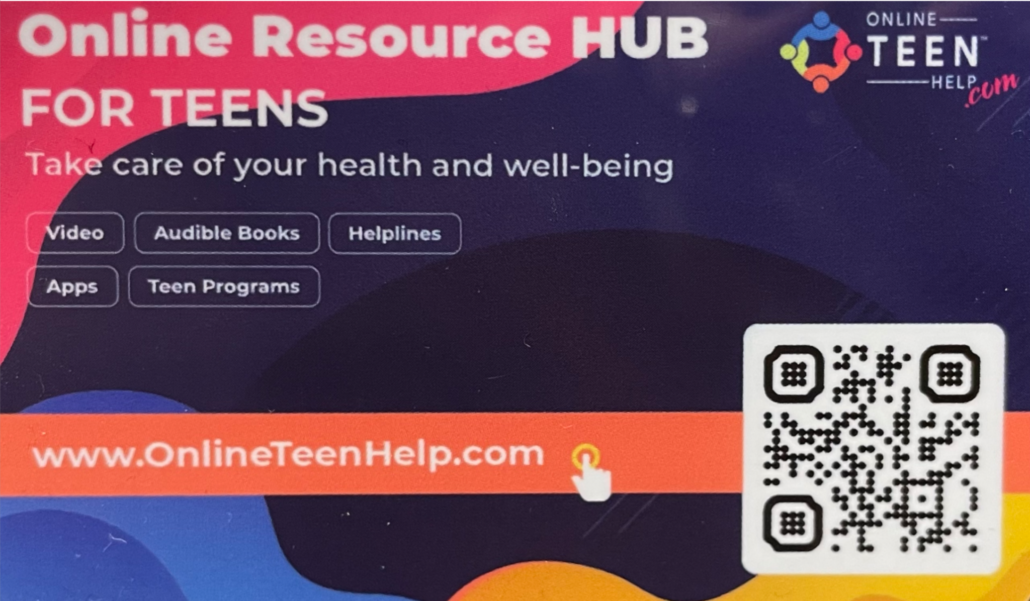
CoMMUNITY RESOURCES
Helplines
Videos
Apps
Teen Programs
Audible Books
Scan the QR code to download resources and share with others!

Slide 4
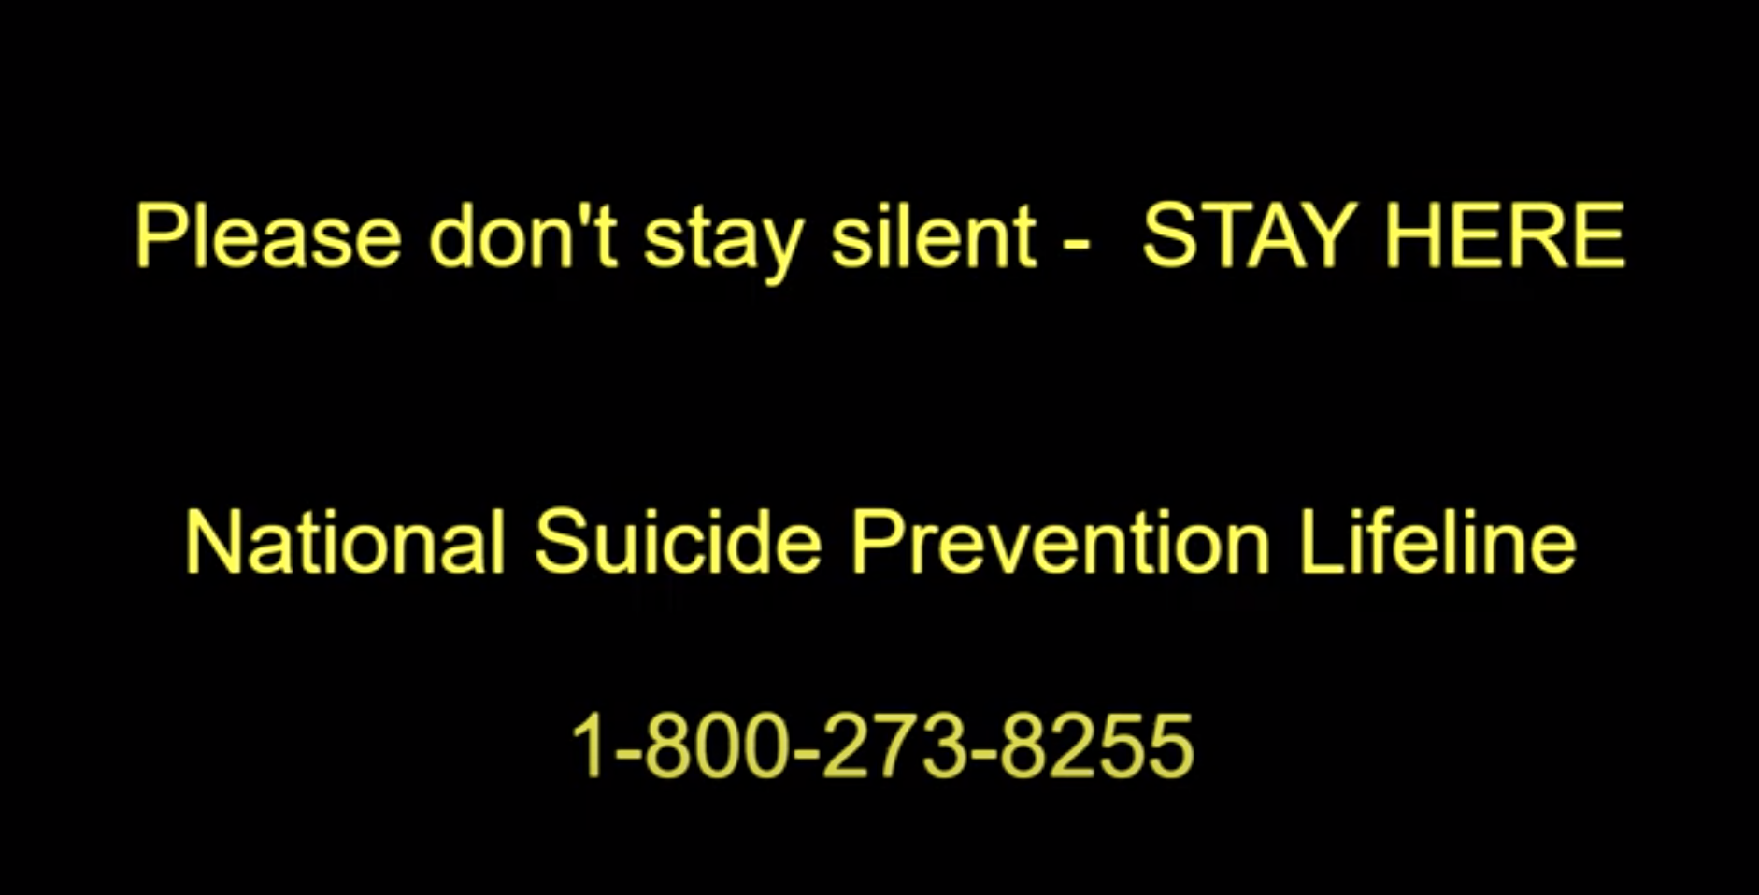
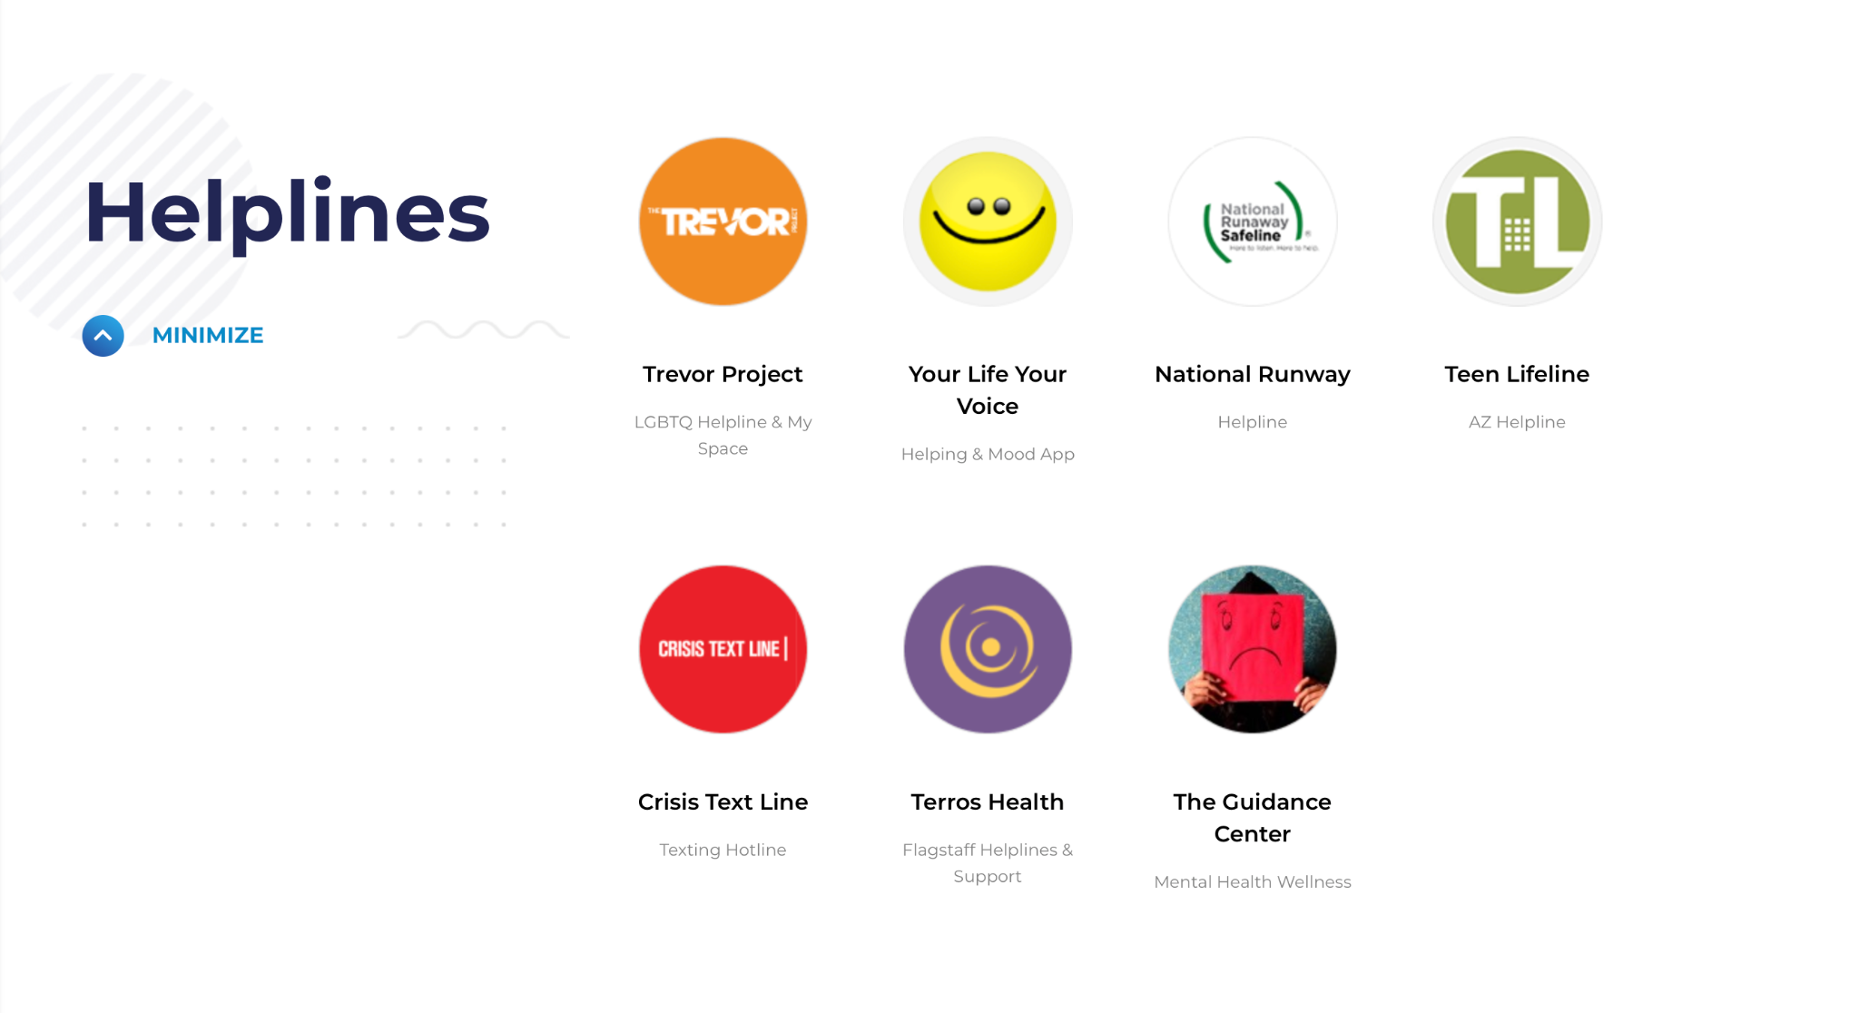



Helplines

Slide 5

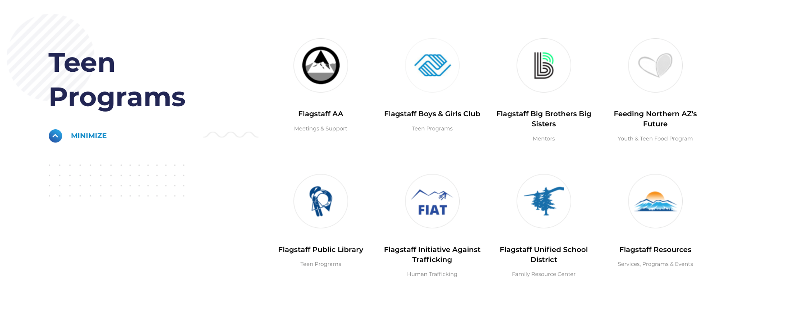

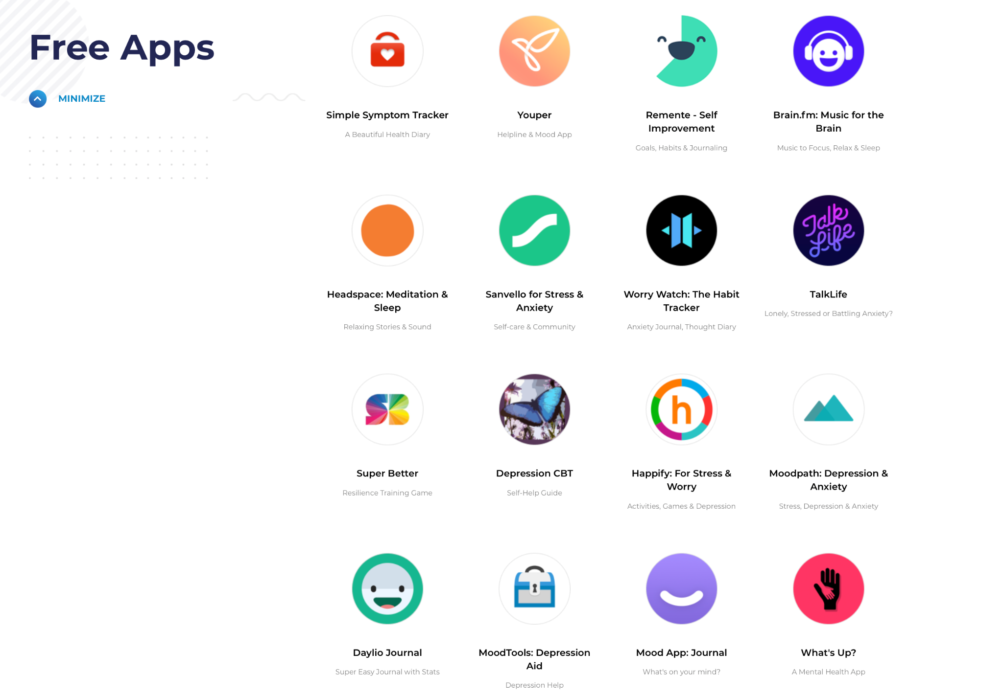
Videos, APPS, teen programs, audible books

Slide 6
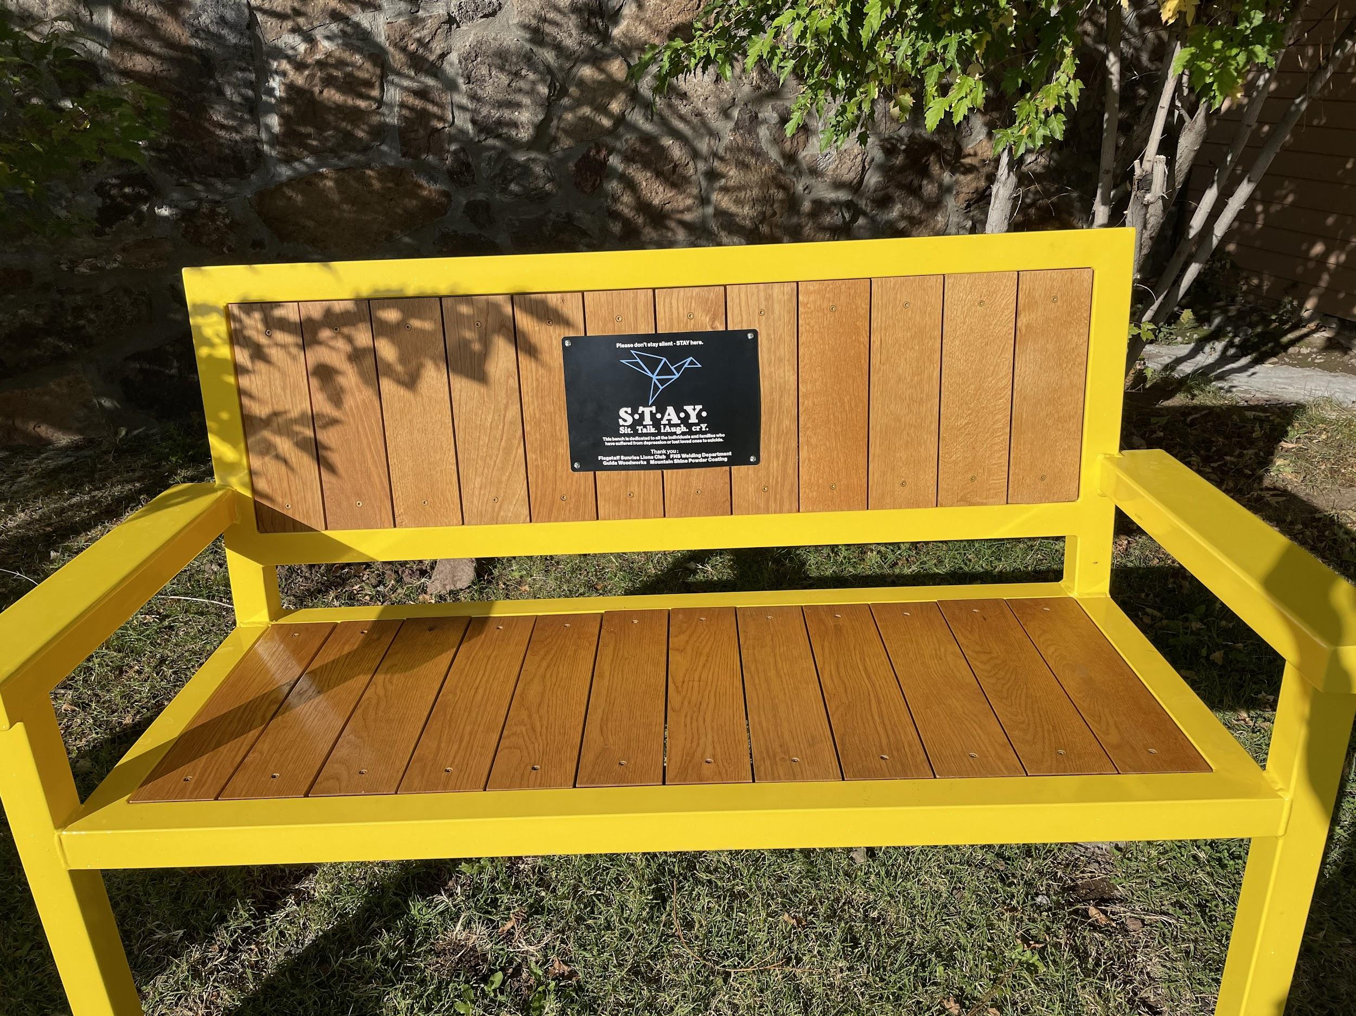

JUST STAY Suicide Prevention BENCH

Slide 7


Slide 8


Slide 9
Thank you!
We will be back next month with more social emotional tips, tricks, and support!
In the meantime, feel free to stop by Student Support Services

